Slide 1
Bash parsing

Slide 2
Hello!
Name of members ID’s
Asifuzzaman 2015-2-60-012
Shaykh Siddique 2016-1-60-053
Md. Mobinul Hoque 2015-2-60-082

Slide 3
Overview
Introduction
What is ANTLR
What is bash
How it works
Project work
Input
Parse tree
Code
Conclusion

Slide 4
What is ANTLR?
Another tool for language recognition.
Parse generator (ANTLR).
Purdue compiler construction tool set (PCCTS).
First developed in 1989.
Under development.
Can generate lexers, parsers, tree parser, combined lexer-parser.

Slide 5
What is bash?
BASH stands for Bourne Again Shell .
First released in 1989.
BASH is a shell written as a free replacement to the standard bourne shell.
Written by Steve bourne for UNIX system.
Make easier to program and use from the command line.

Slide 6
Bash
Bash a scripting language, used in command line interface shell.
There are many other languages for shell scripting like sh, bash, csh, tcsh, batch(windows).
Command line interface shells are mostly used to remote access connection of a server.

Slide 7
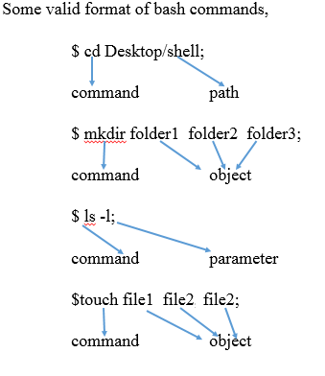
Bash
Semicolon: separation for every single command line.

Slide 8
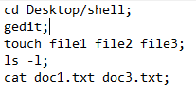
Input
String has two types
Path
object
One parameter which start with dash (-)

Slide 9
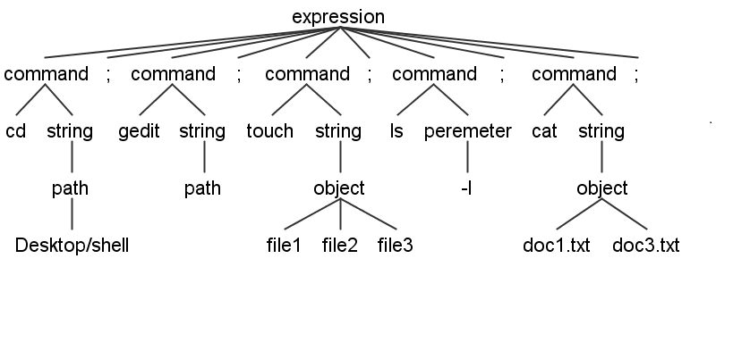
Parse tree

Slide 10
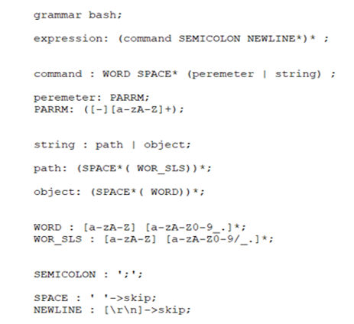
Grammar G4

Slide 11
Compile command
antlr bash.g4 (bash.g4 is our bash file)
javac bash*.java
grun bash expression input.txt –gui
Researching on internet, we are the first as writing grammar for Bash in ANTLR.

Slide 12


Slide 13


